Slide 1
ACCT-GB.2350: Financial Data Management and Analysis
Financial Data Analysis with Python

Slide 2
Schedule
Session | Date | Topic | Assignment
1 | Feb 6-7 | Introductory Concepts | Reading Assignment 1
2 | Feb 13-14 | Getting Started with Excel VBA | Reading Assignment 2
3 | Feb 20-21 | Excel VBA and Data Tools | HW1: Excel VBA
4 | Feb 27-28 | More VBA & Excel Shortcuts | Reading Assignment 3
5 | Mar 5-6 | Relational Databases & Excel | HW2: SQL
6 | Mar 12-13 | NoSQL, Data Preparation with Python
6 | Mar 19-20 | SPRING BREAK
7 | Mar 26-27 | Data Preparation & Analysis with Python | Midterm
8 | Apr 2-3 | Financial Data Analysis with Python
9 | Apr 9-10 | Data Visualization with Power BI | HW3: Python Data Analysis
10 | Apr 16-17 | Power BI | HW4: Power BI
11 | Apr 23-24 | Unstructured Data & Natural Language Processing | Final Project (Group)
12 | Apr 30-31 | Final Project Presentations | Take Home Final (Personal)
ACCT-GB.2350

Slide 3
Web Scraping

Slide 4
Scraping financial data from the web
If we trust the source, the internet can be a valuable repository of information for data analysis.
Within a company, particularly large ones, data is carefully managed and protected from unauthorized access (usually).
If we are authorized, we can use Python, Excel, or Power BI to connect to any of this information (usually).
We’ll begin by building a scraper of financial data using Excel.

Slide 5
These tools can make acquisition and analysis of financial data easier
Things to come:
Scraping data from the web (Yahoo Finance)
Scraping 10k Information from Edgar
Summarizing & automating common modeling tasks using this data
Further enhancing your analysis
Textual analysis
Other data with macroeconomic or market significance

Slide 6
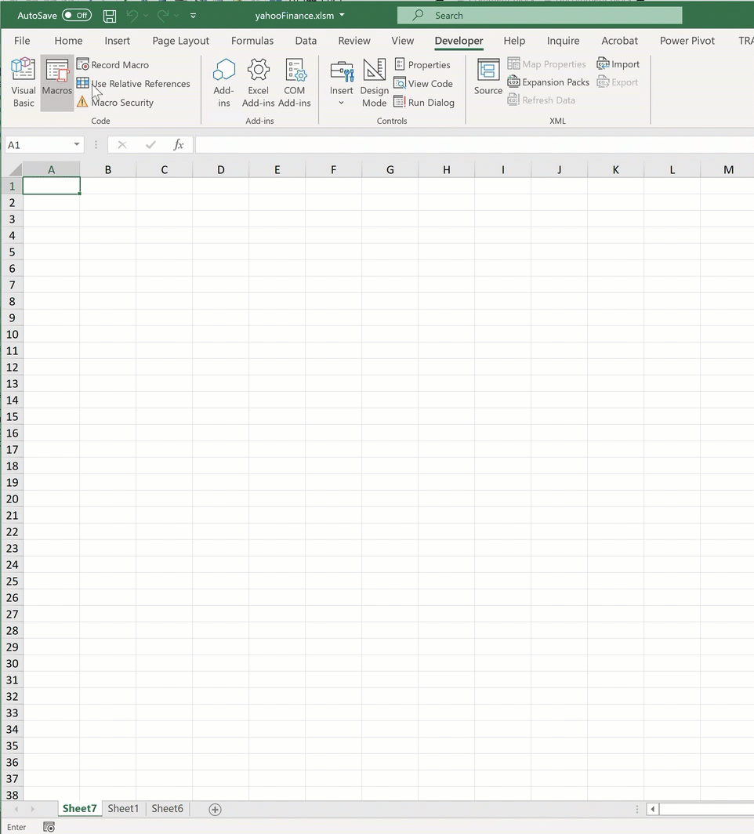
An example automation from a previous quarter with Professor Yeo

Slide 7


What is web scraping?
Consider a search engine like Google:
It crawls a bunch (every) website and creates a searchable index of the site contents
Another term for web crawling is scraping
A web scraping application is used to retrieve specific content from a specific site or page, usually without any (or very little) human input
There are many different approaches and languages that can be used to scrape
My preferred scraping tools:
But of course, VBA works well too! And it’s integrated within Excel, making it easy to apply to existing data and share with others.
Web scraping in Excel is Windows (PC) Only!! Mac users, launch Excel in your Apps@Stern environment

Slide 8
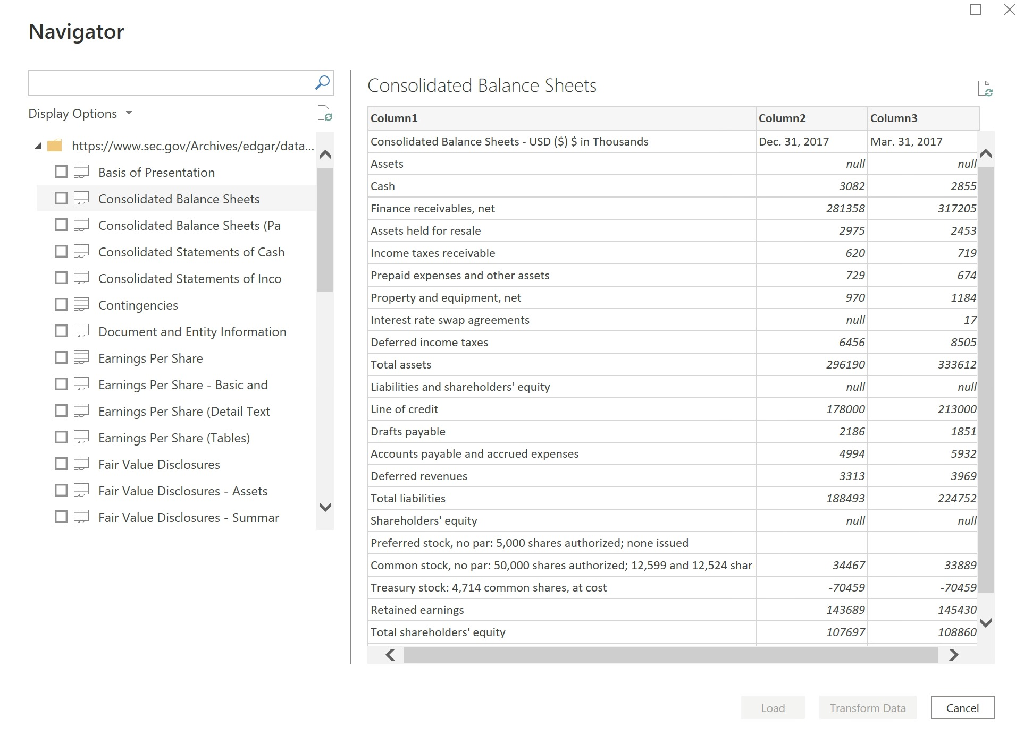
Scraping example using Power BI
In the coming weeks, we’ll spend time exploring brand new methods for acquiring financial information.
The only downside is that many times you may be in a corporate setting where some of these modern tools aren’t available.

Slide 9
Scraping example using VBA
This week is all about using VBA, and there are still plenty of options for acquiring data from the web using only Excel (which, practically every business user has access to).
This code is a little longer than what you might see in other tools, but it’s still effective.
Sub simplePage1()
' Tools -> References -> Microsoft VBScript Regular Expressions 5.5
' Tools -> References -> Microsoft Scripting Runtime
Dim html As MSHTML.HTMLDocument
Set html = New MSHTML.HTMLDocument
With CreateObject("MSXML2.ServerXMLHTTP")
.Open "GET", "http://34.123.146.157/", False
.send
html.body.innerHTML = .responseText
End With
' get all paragraph elements
Dim hP As Variant
Set hP = html.getElementsByTagName("p")
Dim r, c As Integer
r = 0
c = 0
'label
ActiveCell.Offset(r, c) = hP(0).innerText
'values
ActiveCell.Offset(r, c + 1) = hP(1).innerText
End Sub

Slide 10
What is HTML?
In order to scrape using VBA, we’ll need to understand a little bit about HTML.
HTML stands for Hyper Text Markup Language
HTML is the standard markup language for creating Web pages
HTML describes the structure of a Web page
HTML consists of a series of elements
HTML elements tell the browser how to display the content
HTML elements label pieces of content such as "this is a heading", "this is a paragraph", "this is a link", etc
https://www.w3schools.com/html/html_intro.asp

Slide 11
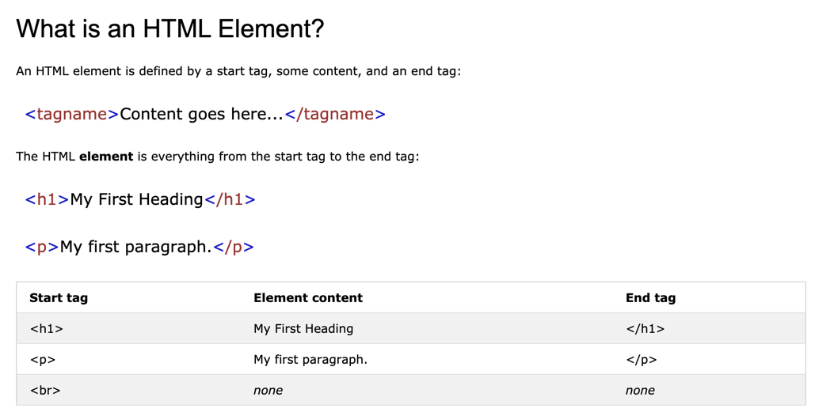
HTML crash course
https://www.w3schools.com/html/html_intro.asp

Slide 12
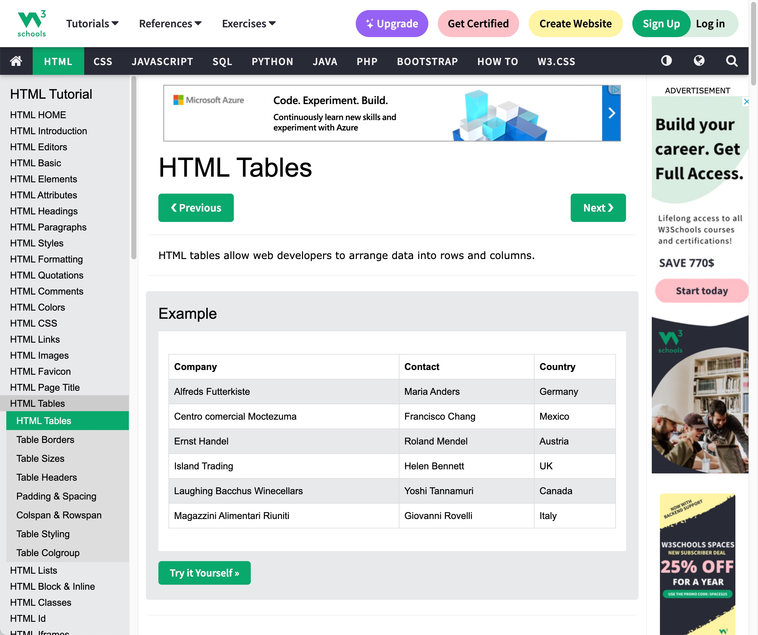
Scraping from a very simple web page
Visit: https://www.w3schools.com/html/html_tables.asp
What are the elements and values on this page?
Where can I view a file like this?
Open it in chrome and inspect values

Slide 13
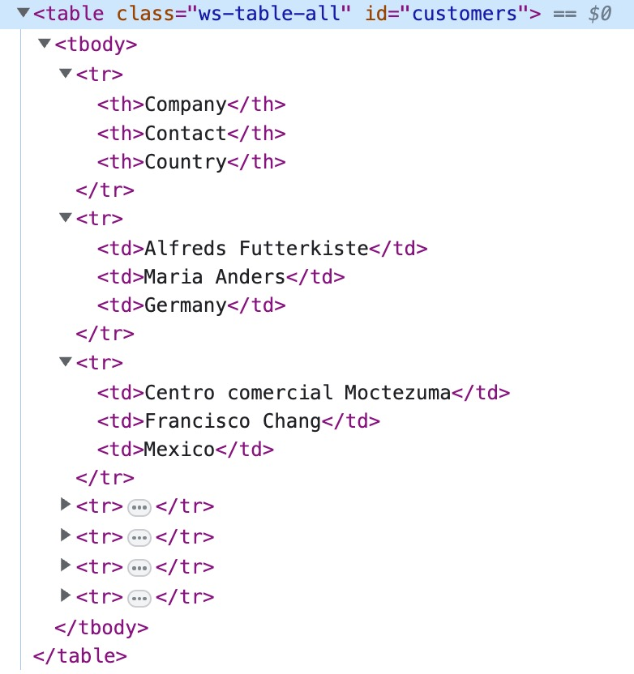
How do HTML tables work, exactly?
Don’t be intimidated!
We’re going to go through the table:
row by row
cell by cell

Slide 14
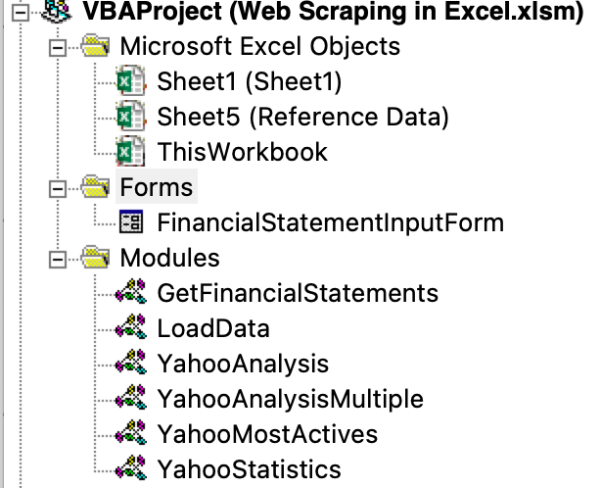
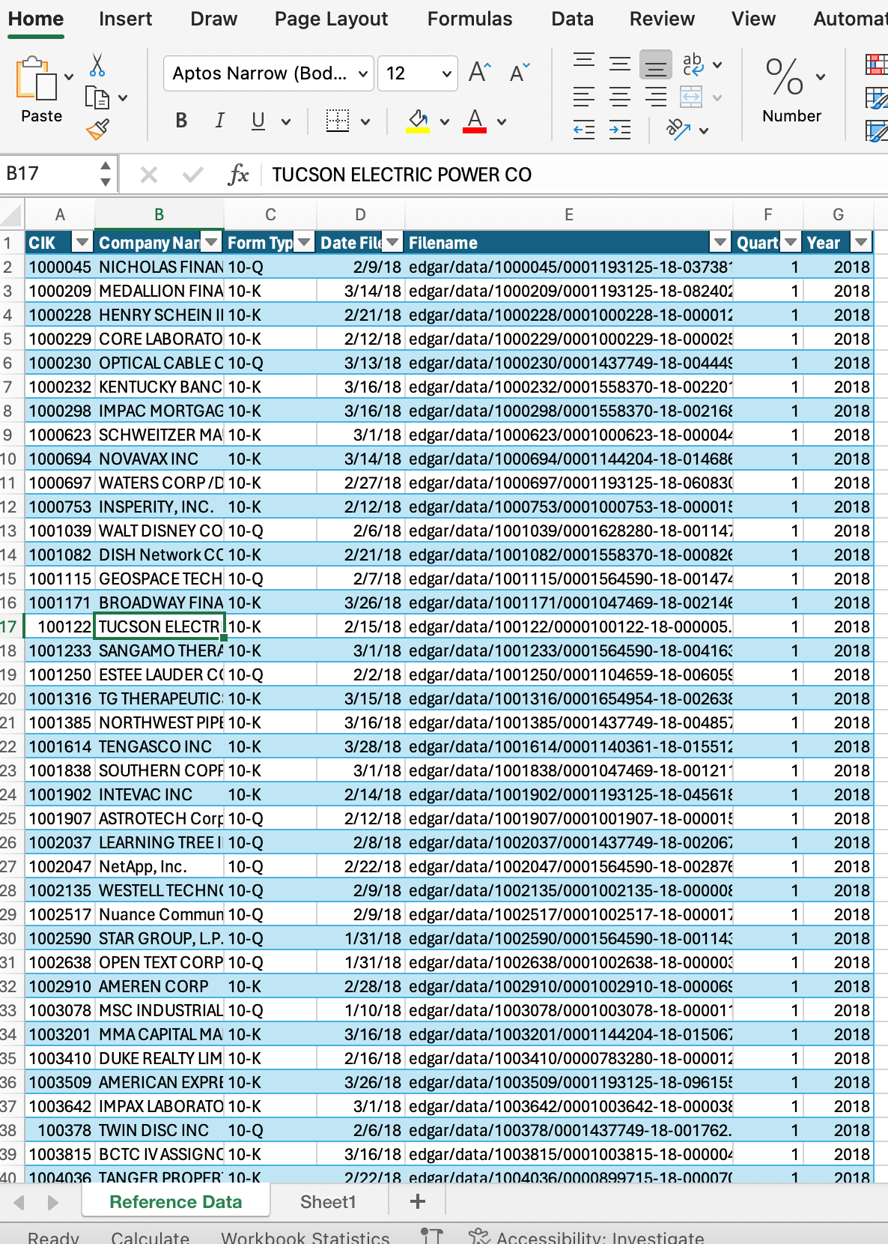
The next several examples will use ”Web Scraping in Excel.xlsm”
Look for the file on Brightspace
This code does not run in Excel for Mac

Slide 15
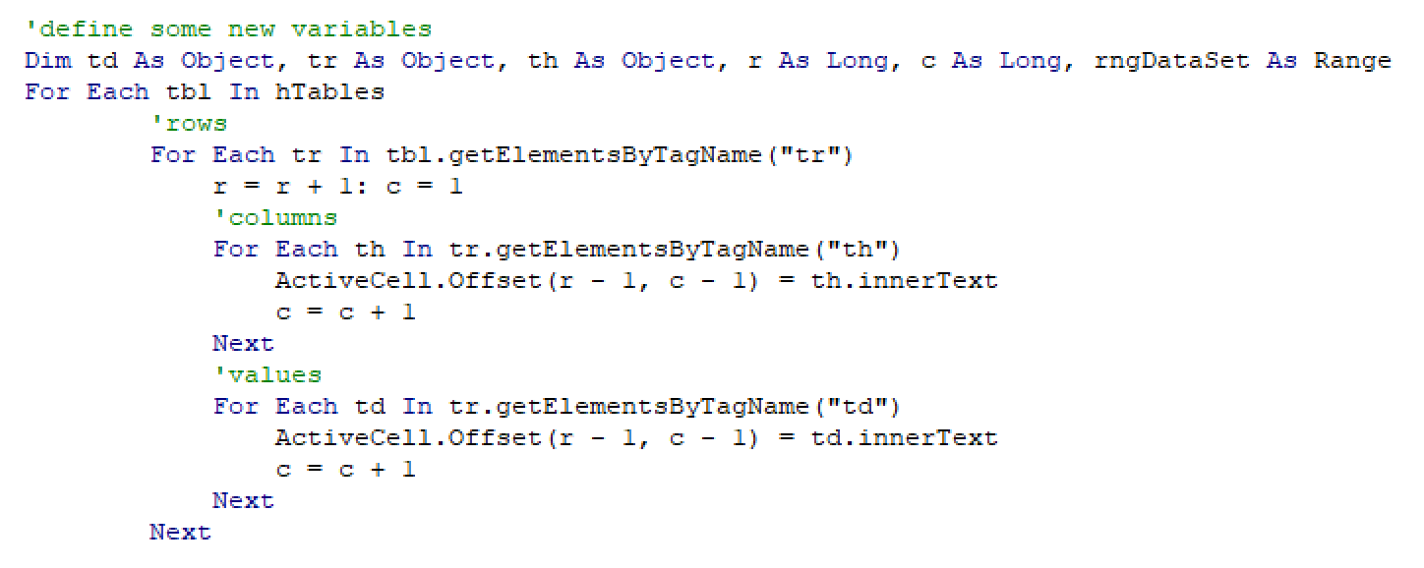
VBA Code Walkthrough
Open the module called YahooMostActives
Because this is VBA, it will take a little longer to write than the equivalent in Python
However, it’s still straightforward once you understand how tables work.

Slide 16
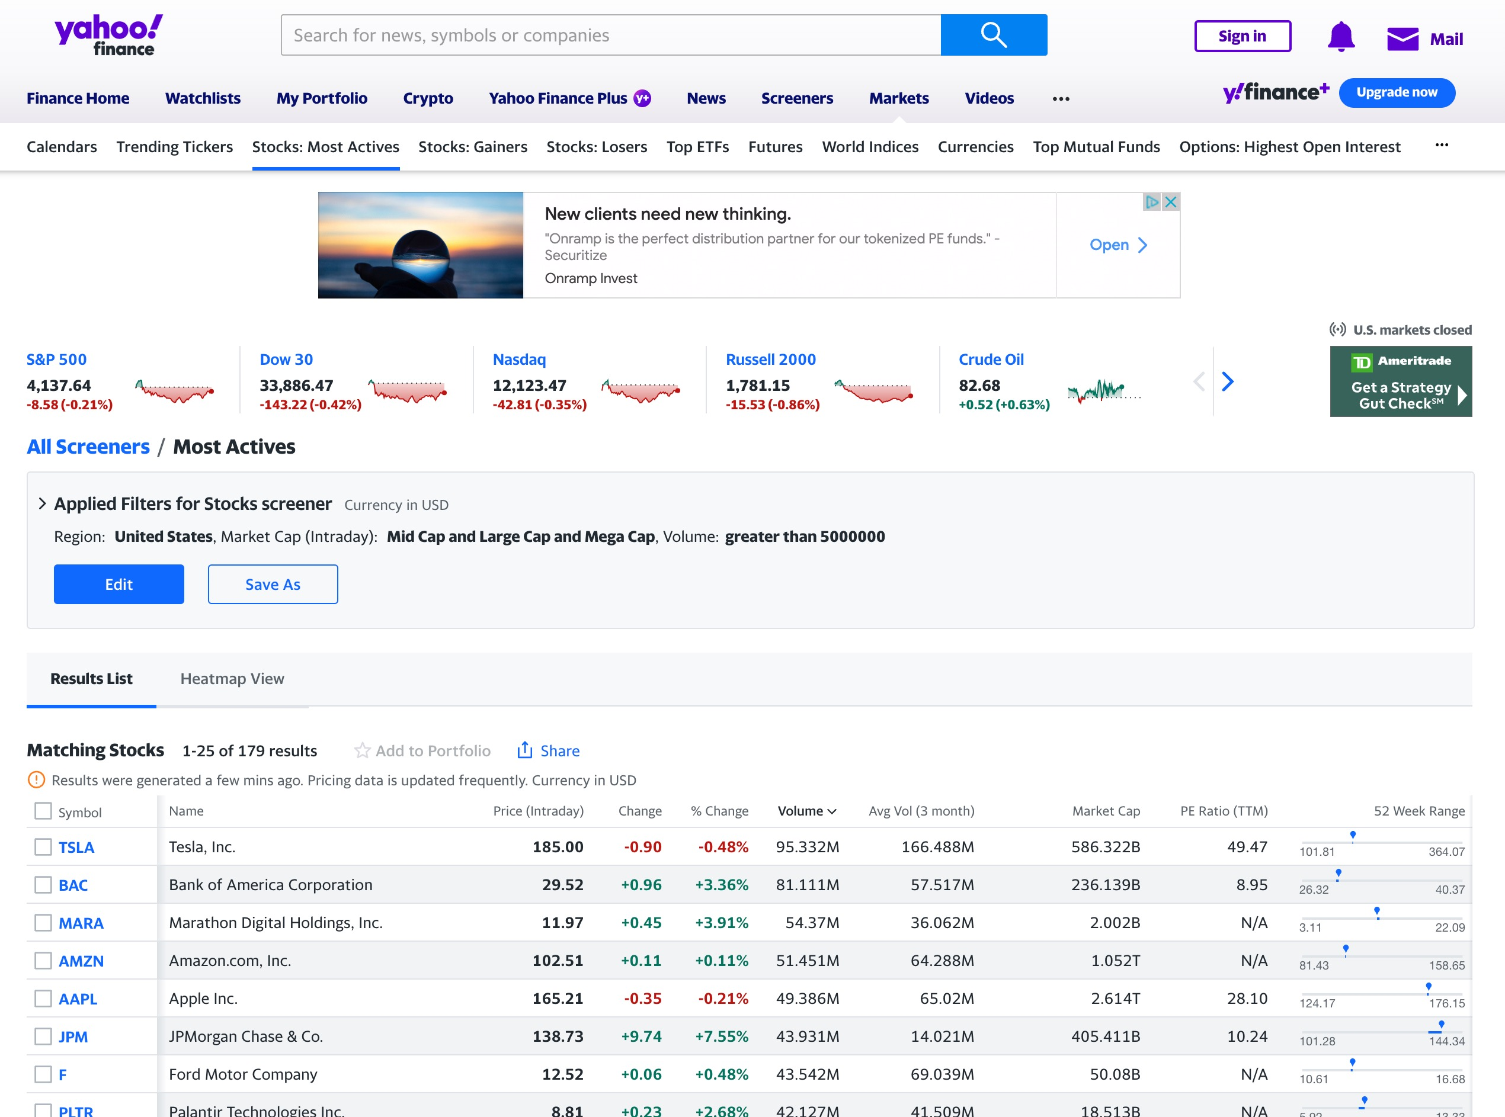
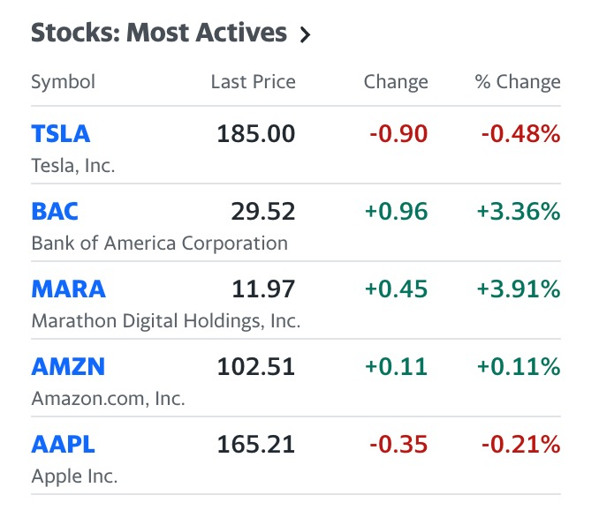
Yahoo Finance Most Actives
On the Yahoo Finance home page there is a link and section called Most Actives.
Together, let’s use what we learned last week to scrape the data and add it to a sheet.
https://finance.yahoo.com/most-active
Notes:
https://finance.yahoo.com/most-active/?.tsrc=fin-srch

Slide 17
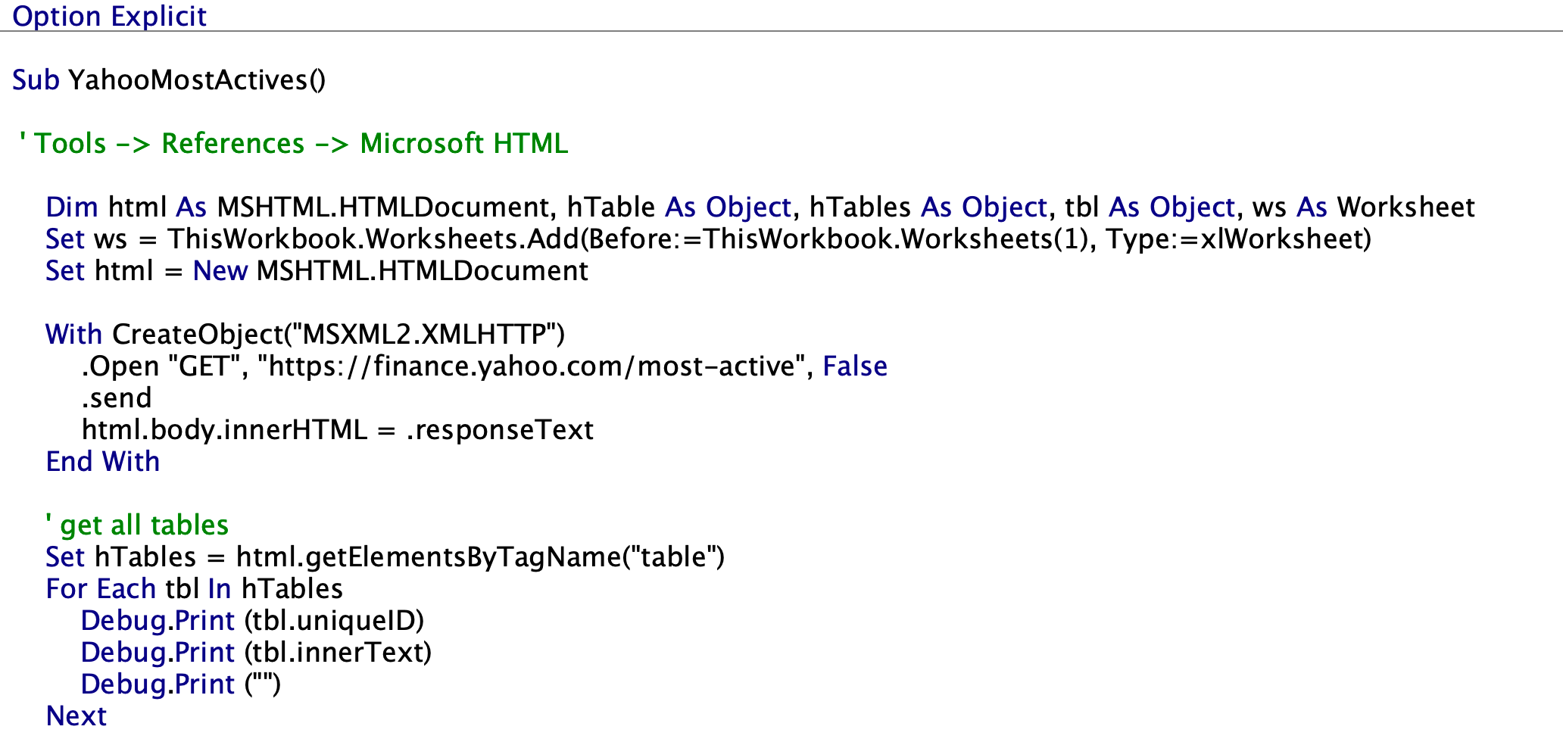
Yahoo Most Actives macro
Because the Most Actives Page only has one table, our job is pretty easy.
Let’s just search for all tables on the page, and add them to a new tab.

Slide 18
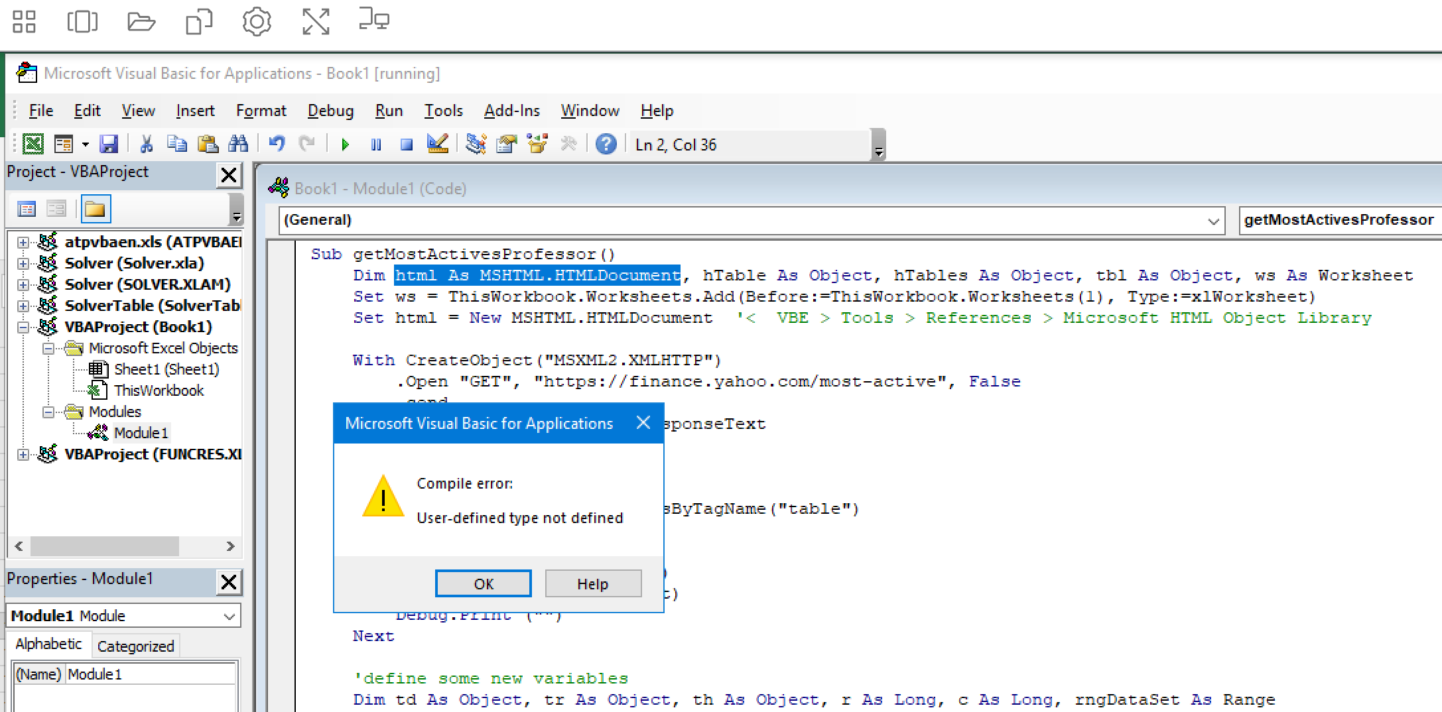
Web Scraping Prerequisites in Excel
Notice how additional Microsoft libraries are required for this code to run. If you’re on a Mac, it will not work. There is a dependency on Internet Explorer on the machine running this code.

Slide 19
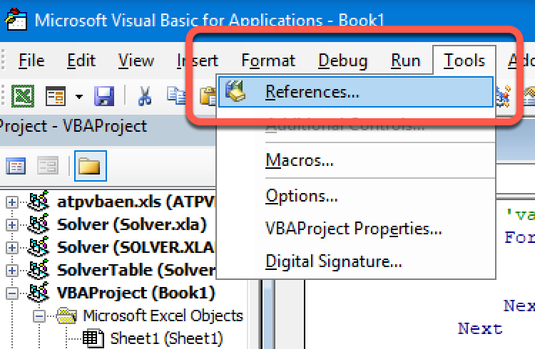
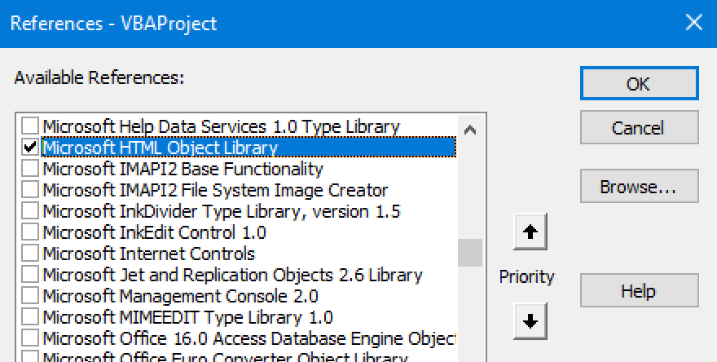
VBE -> Tools -> References -> Microsoft HTML Object Library
Notice how additional Microsoft libraries are required for this code to run. If you’re on a Mac, it will not work. There is a dependency on Internet Explorer on the machine running this code.

Slide 20
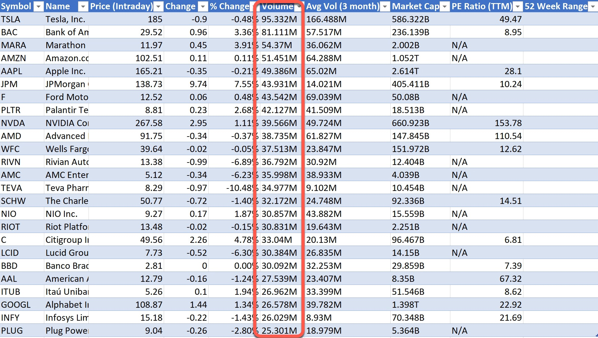
What can we improve?
Did you notice the volume column?
We can’t very easily perform calculations on this given that you may see “M” or ”K” or “B” in it (millions, thousands, or billions)

Slide 21
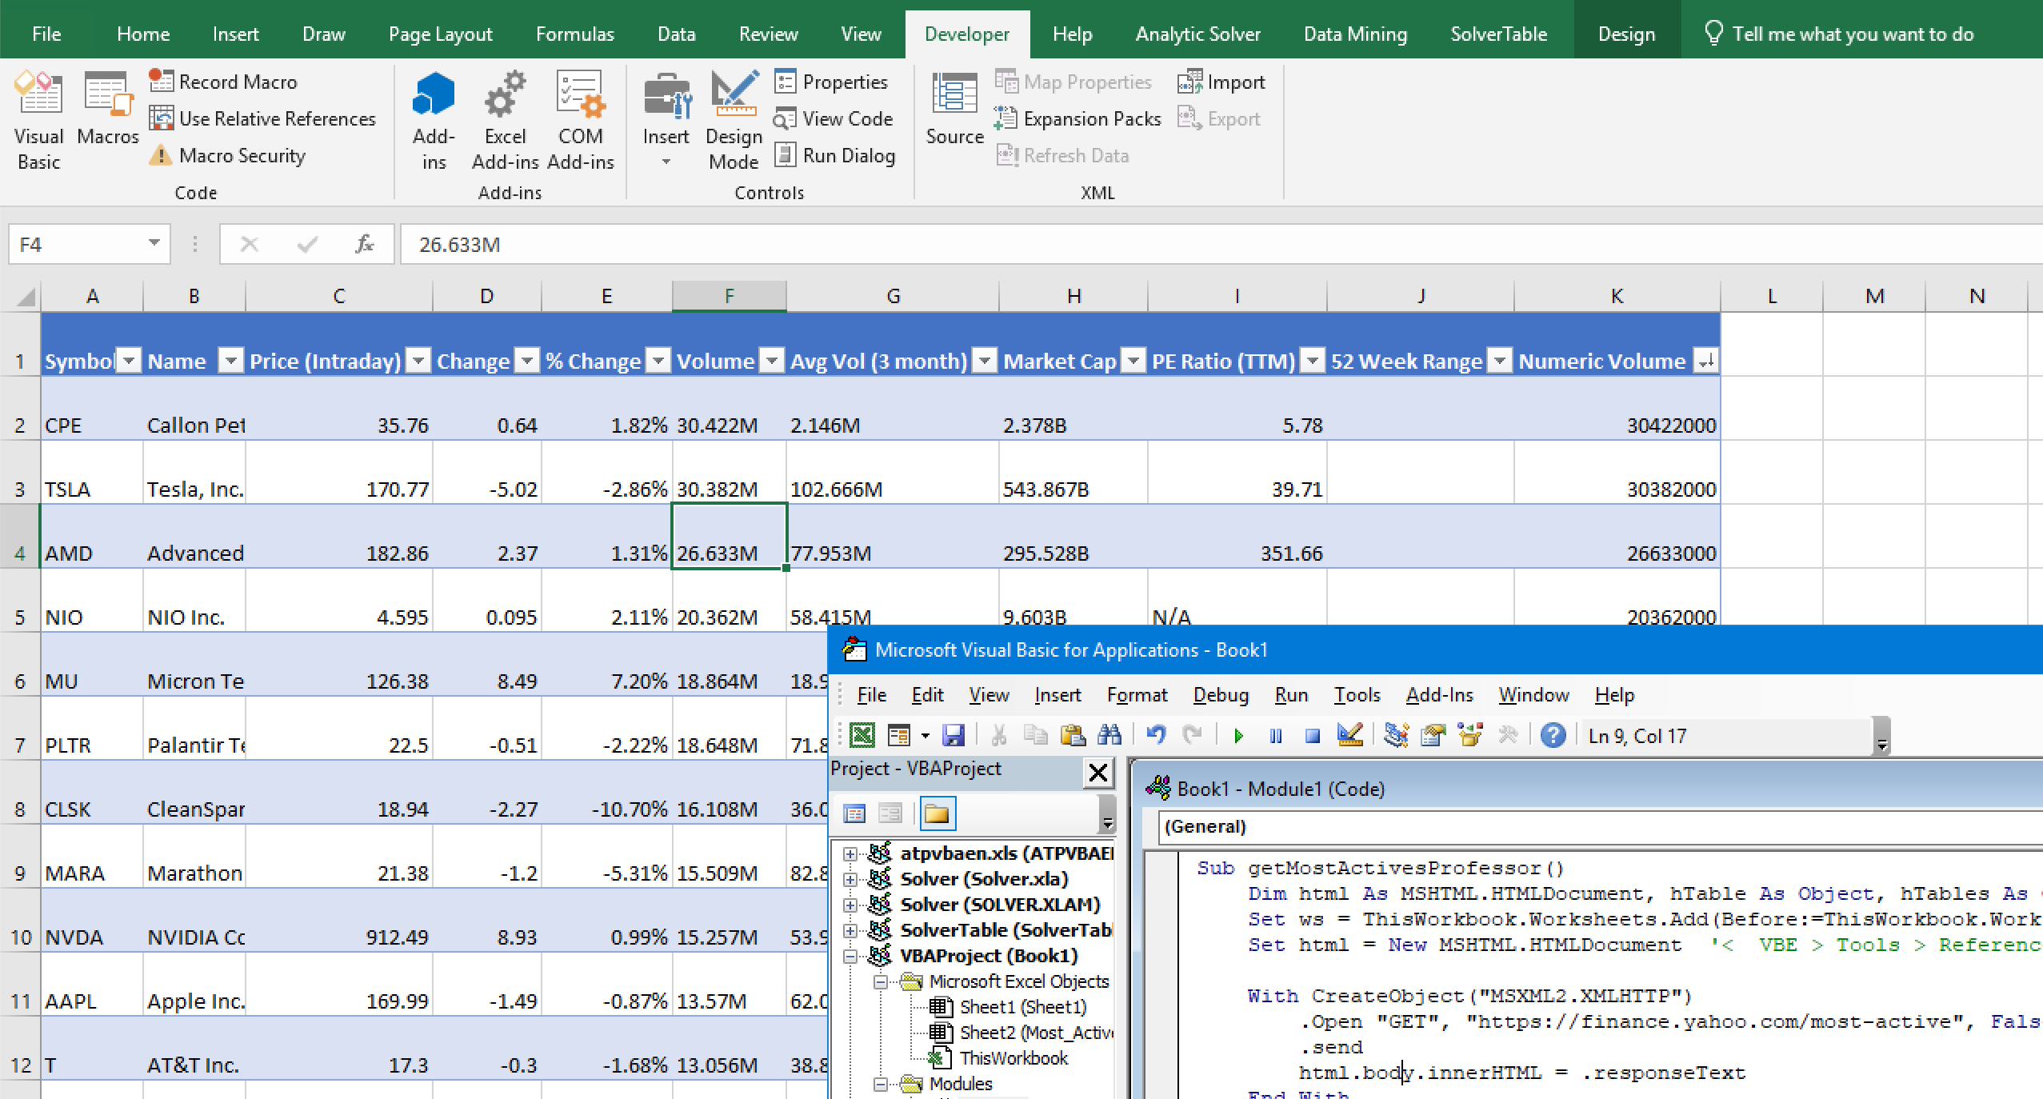
Success
Now you can move ahead and create charts, pivot tables, etc.

Slide 22
How can we handle strangely formatted values?
This line creates a new column called “Numeric Volume”:
ActiveSheet.ListObjects("Most_Active_Stocks").ListColumns.Add.name = "Numeric Volume"
This line checks for errors, applies formulas, and then applies formatting:
ActiveSheet.ListObjects("Most_Active_Stocks").ListColumns("Numeric Volume").DataBodyRange.FormulaR1C1 =
"=IFNA(LEFT(Most_Active_Stocks[@[Volume]],LEN(Most_Active_Stocks[@[Volume]])-1)*CHOOSE(MATCH(RIGHT Most_Active_Stocks[@[Volume]],1), {""K"",""M"",""B""},0),1000,1000000,1000000000),Most_Active_Stocks[@[Volume]])"

Slide 23
More Formatting
This line creates a new column called “Numeric Volume”:
ws.name = "Most_Active_" & Format(Now, "YYYY-MM-DD")
These lines reset any existing sorting, and then apply a new sort based on the new column:
ActiveSheet.ListObjects("Most_Active_Stocks").Sort.SortFields.Clear
ActiveSheet.ListObjects( _
"Most_Active_Stocks").Sort.SortFields.Add Key:=Range( _
"Most_Active_Stocks[[#All],[Numeric Volume]]"), SortOn:=xlSortOnValues, _
Order:=xlDescending, DataOption:=xlSortNormal
With ActiveSheet.ListObjects( _
"Most_Active_Stocks").Sort
.Header = xlYes
.MatchCase = False
.Orientation = xlTopToBottom
.SortMethod = xlPinYin
.Apply
End With

Slide 24
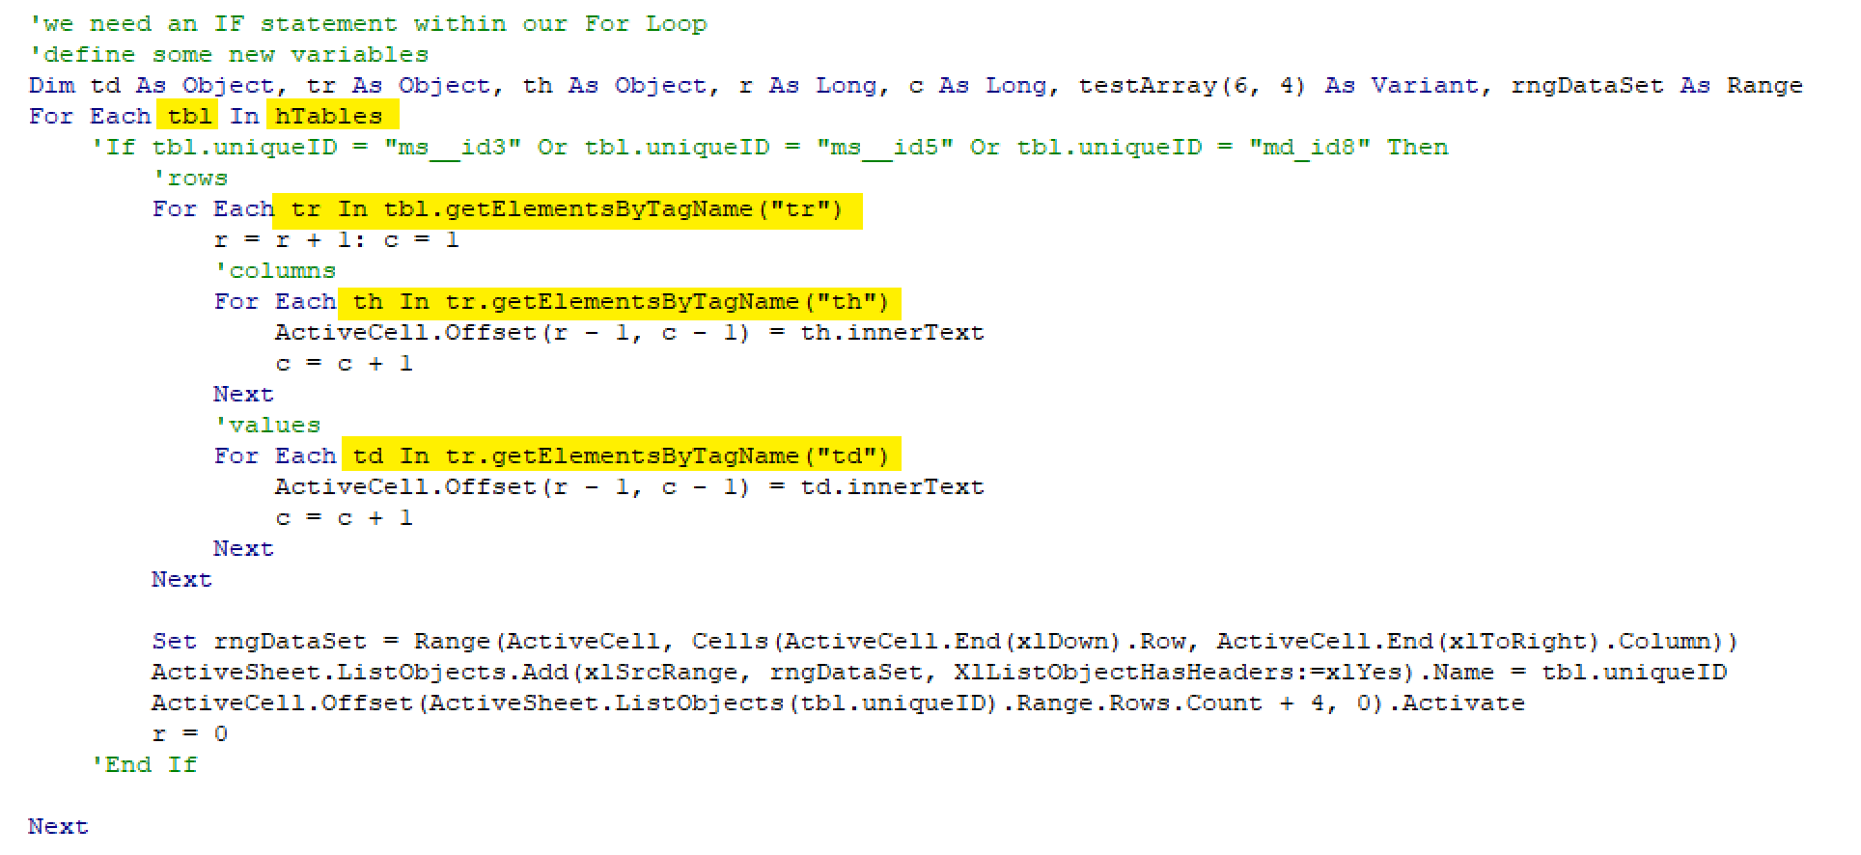
Yahoo Analysis (Single Ticker)
Take a close look at the For loops that evaluate and extract text from the HTML tables on this page.

Slide 25
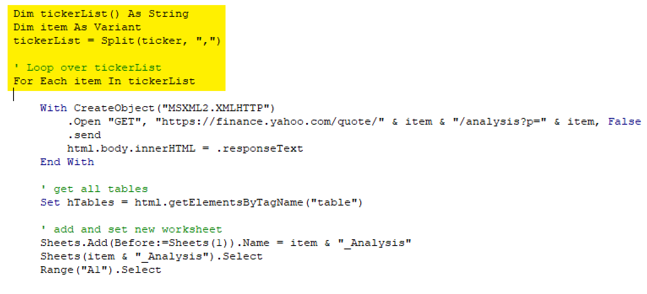
Yahoo Analysis (Mutliple Tickers)
This time we create a macro to gather data for multiple companies at once e.g., to perform analysis over an entire industry or set of competitors. The only material difference this time is creating a list of tickers and adding a new outer For loop with the same functions inside (including loading a new page).

Slide 26
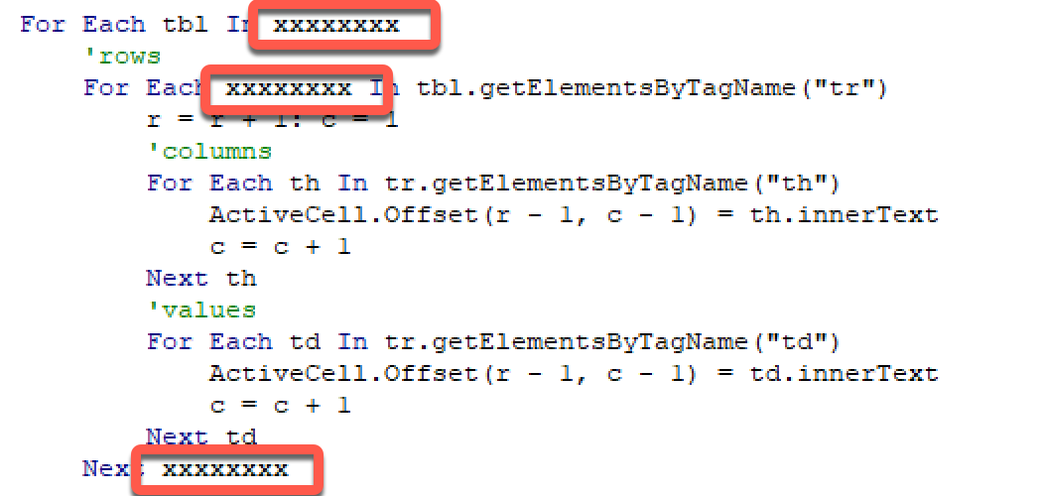
Yahoo Statistics
Before this macro will run, you will need to update some of the variables

Slide 27
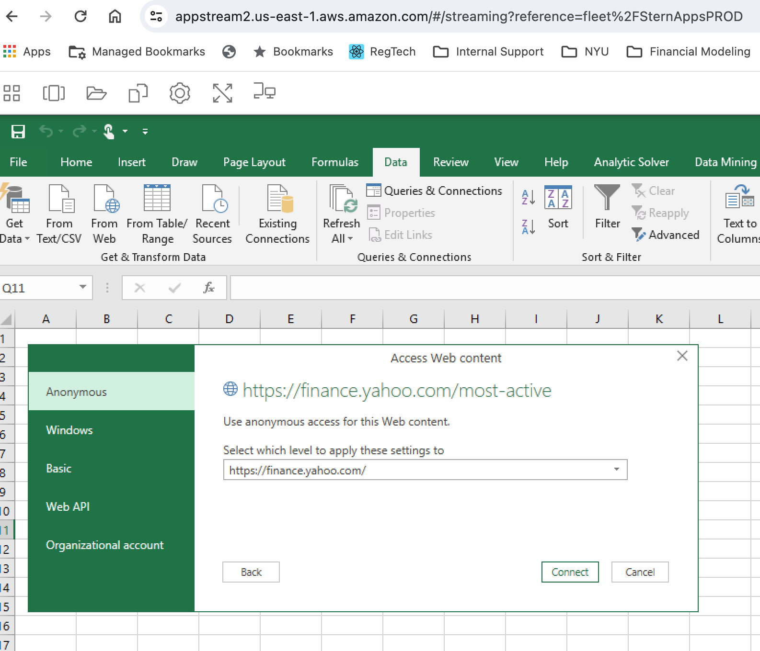
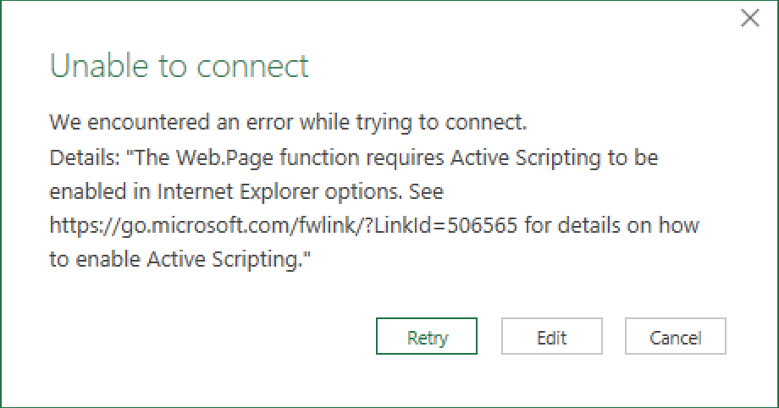
Built-in Excel Feature
We might also have an easy button.
Although you may see this, or not have the “From Web” option in your version of Excel.

Slide 28
Break

Slide 29
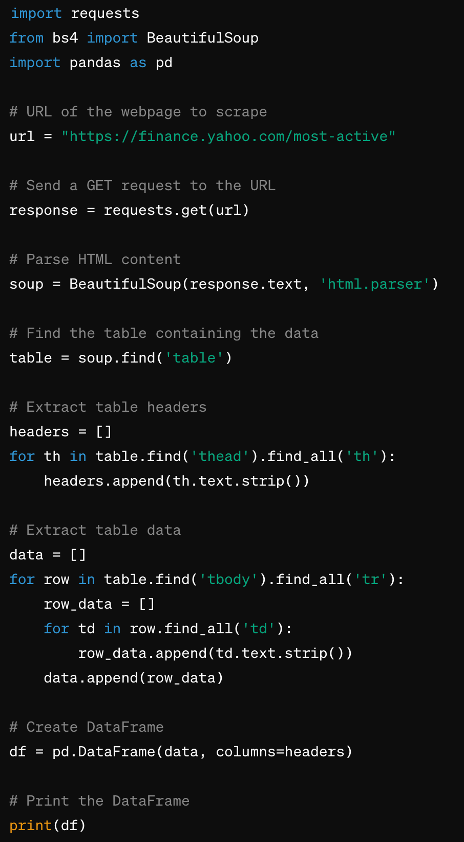
Yahoo Most Actives Using Python
You decide which you like better, or which suits your needs better.
1. Import packages and define url
3. Extract the data from the response
2. Create variables to make the request and store the response
4. Build a DataFrame
Notes:
import requests
from bs4 import BeautifulSoup
import pandas as pd
# URL of the webpage to scrape
url = "https://finance.yahoo.com/most-active"
# Send a GET request to the URL
response = requests.get(url)
# Parse HTML content
soup = BeautifulSoup(response.text, 'html.parser')
# Find the table containing the data
table = soup.find('table')
# Extract table headers
headers = []
for th in table.find('thead').find_all('th'):
headers.append(th.text.strip())
# Extract table data
data = []
for row in table.find('tbody').find_all('tr'):
row_data = []
for td in row.find_all('td'):
row_data.append(td.text.strip())
data.append(row_data)
# Create DataFrame
df = pd.DataFrame(data, columns=headers)
# Show the DataFrame
df

Slide 30
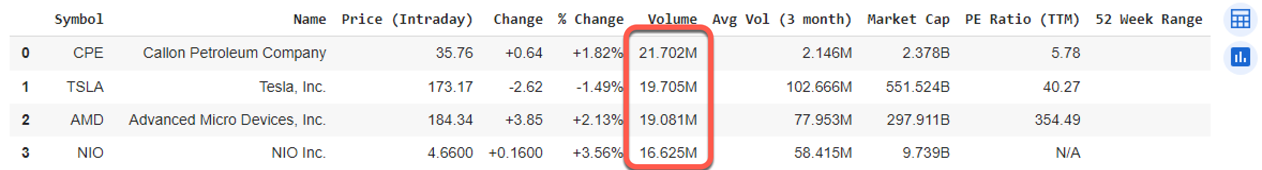
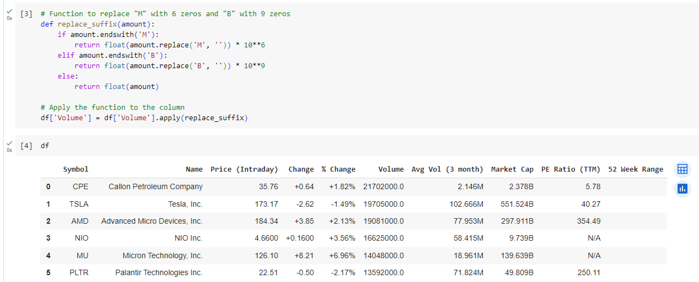
Cleaning the data
I find this version to be much easier than the previous example in Excel
Before
After
Notes:
# Function to replace "M" with 6 zeros and "B" with 9 zeros
def replace_suffix(amount):
if amount.endswith('M'):
return float(amount.replace('M', '')) * 10**6
elif amount.endswith('B'):
return float(amount.replace('B', '')) * 10**9
else:
return float(amount)
# Apply the function to the column
df['Volume'] = df['Volume'].apply(replace_suffix)

Slide 31
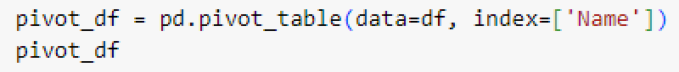
Can Pandas do easy pivot tables or group bys?
pivot_table requires data, and an index parameter
data is the Pandas DataFrame you pass to the function.
index is the feature that allows you to group your data. The index feature will appear as an index in the resultant table. Generally, categorical columns are used as indexes.
Which columns will be aggregated? Why?

Slide 32
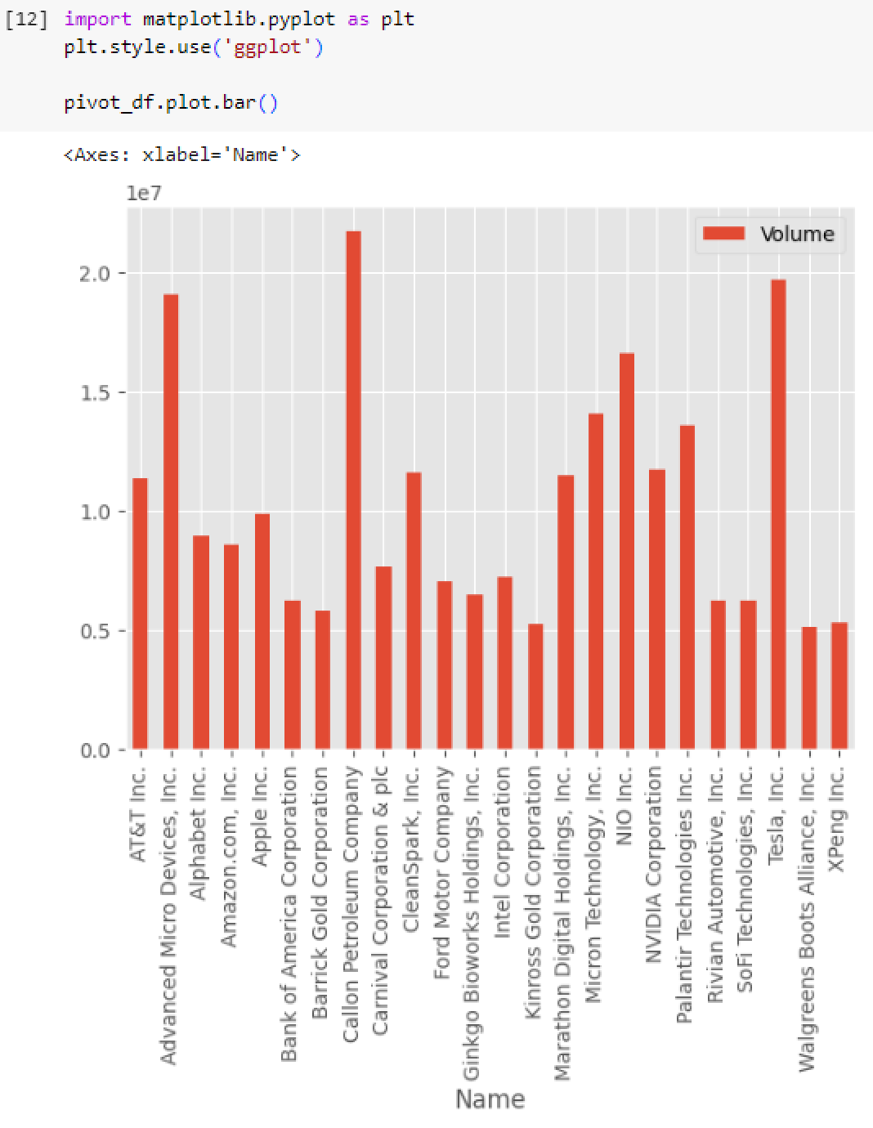
Can Pandas easily create pivot charts?
Version 1 looks OK, but it’s a little hard to read.

Slide 33
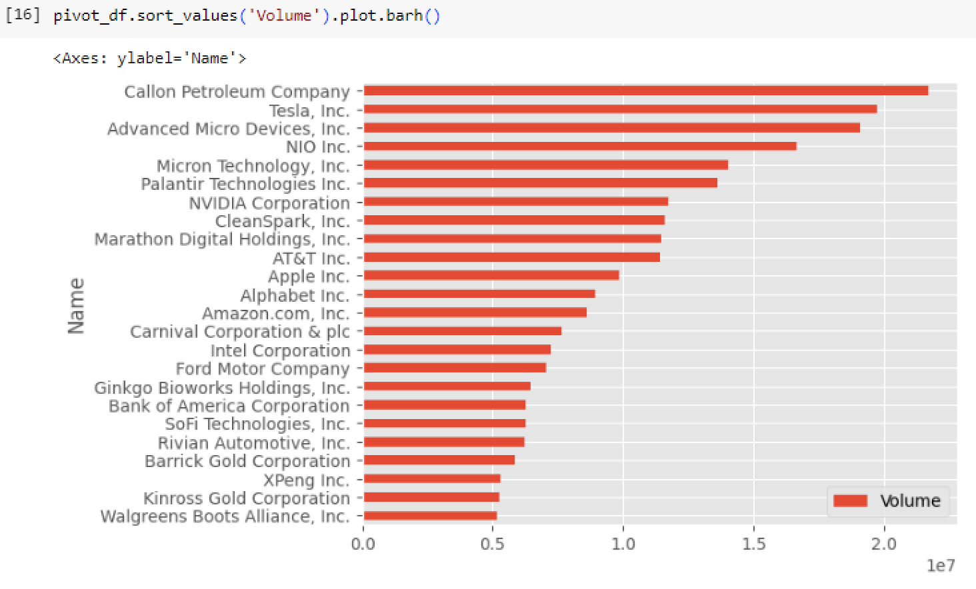
Can Pandas easily create pivot charts?
Version 2 is better

Slide 34
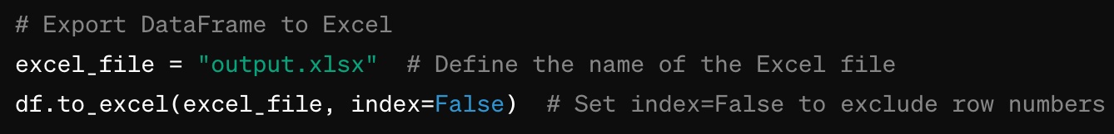
But what if you want the data in Excel?
The Pandas package has created an easy way to allow that.
Be aware that Pandas adds an index column with row numbers (zero based). We typically don’t need this once we move to Excel which is why we set the value of “index” to False.

Slide 35
Dad joke of the night
How did the computer eat its supper?
In megabytes

Slide 36
APIs & Trusted Sources

Slide 37
What is an API?
If you google how to scrape data from Edgar, you’ll find some links with references to APIs. An API is typically preferable to scraping because it is much more reliable.
API stands for application programming interface. This is the way a developer makes the data they manage easier to access.
Most likely you encounter APIs every day without fully realizing it. Common examples are:
Google Maps and search (websites embed a map provided by google)
Your phone’s weather app displays data received from Yahoo’s weather API
ChatGPT
And many, many more

Slide 38

What is an API?

Slide 39
Awesome, right? The catch – APIs usually aren’t free.
Some products, such as sec-api.io, provide a simple API that allows you to make a request and receive nicely formatted data response from nearly every disclosure provided by a company
Alas, this is valuable stuff, so they charge you for it.
The SEC doesn’t necessarily make it difficult to scrape data, but they could make it a lot easier.
All of this to say: use an API if you can. If you can’t, or if you don’t want to pay for one, you’ll have to learn how to scrape (ethically, of course).

Slide 40
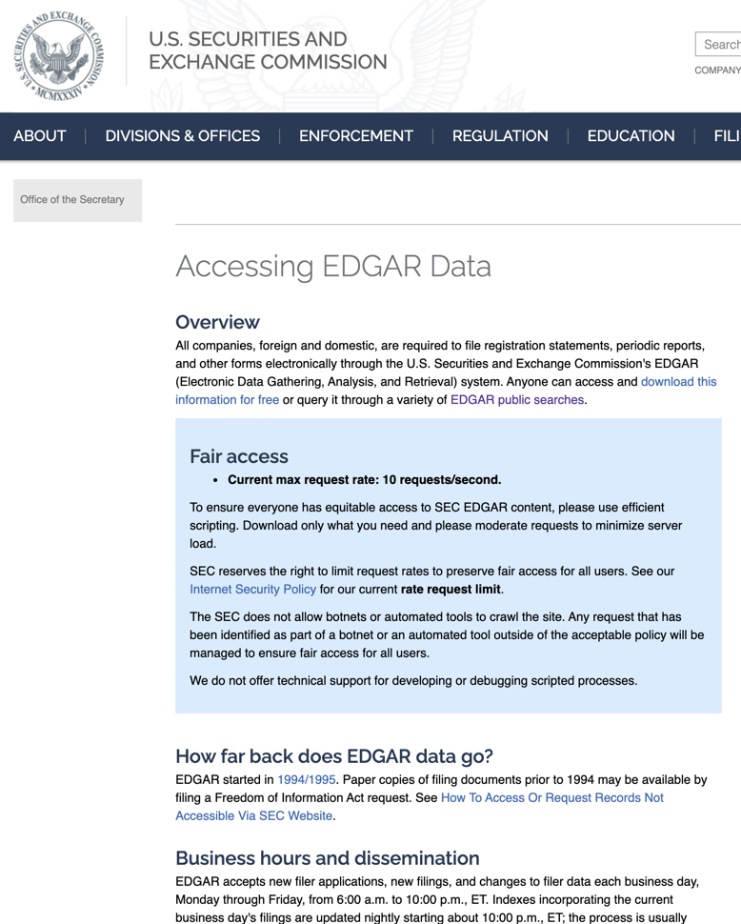
EDGAR doesn’t provide free APIs
Four types of indexes are available:
company — sorted by company name
form — sorted by form type
master — sorted by CIK number
XBRL — list of submissions containing XBRL financial files, sorted by CIK number; these include Voluntary Filer Program submissions
We are not going to build or pay for an XBRL parser in this class. The main things to remember are they are available, and they can require a lot of effort to build and maintain.
✓

Slide 41
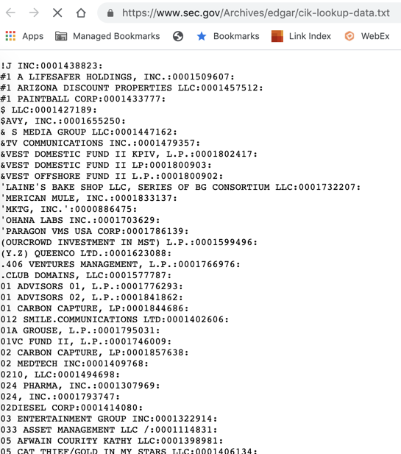
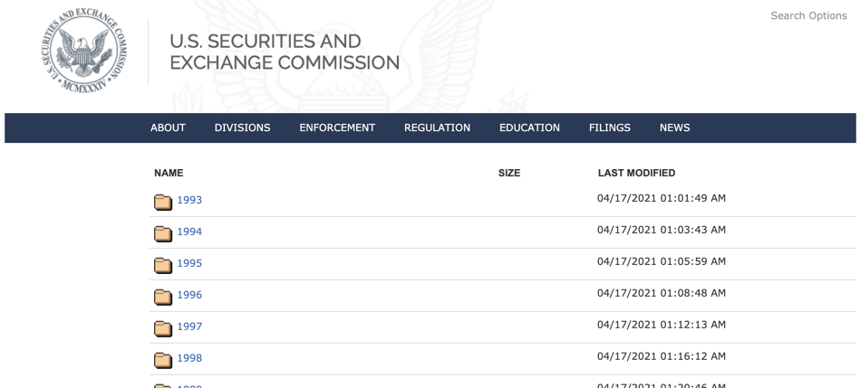
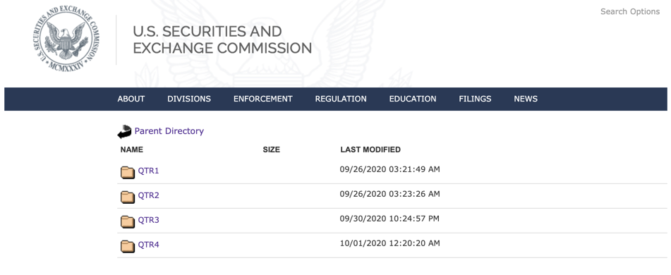
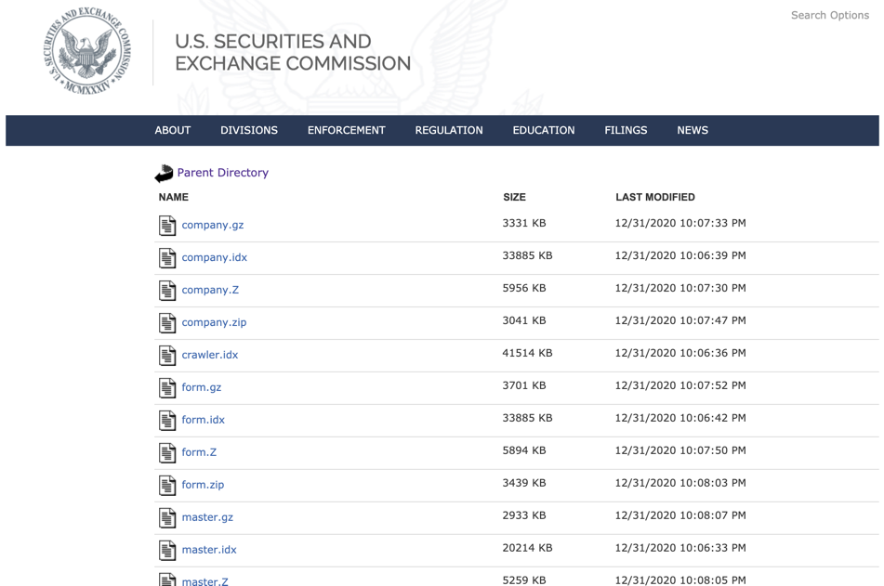
EDGAR doesn’t provide free APIs
If you know how to navigate these two sites and replace URL values, you can look up any disclosure from any period without needing to parse XBRL.
https://www.sec.gov/Archives/edgar/full-index/
https://www.sec.gov/edgar/searchedgar/cik.htm

Slide 42
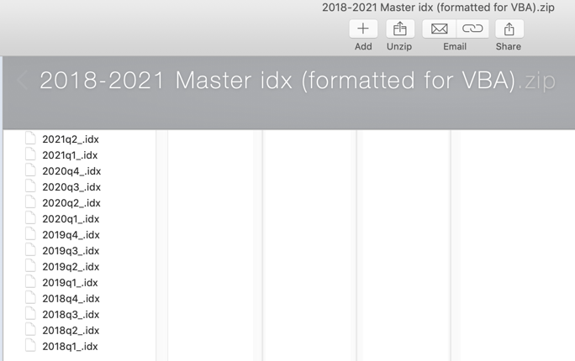
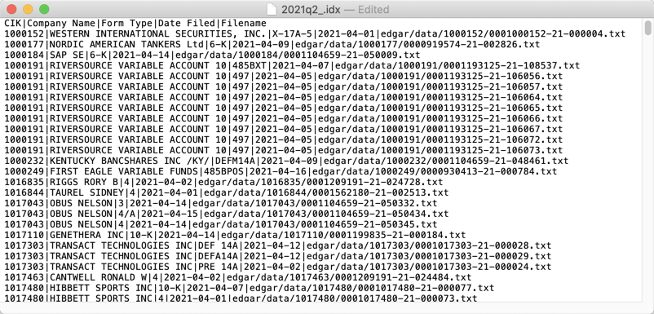
1st step – extract reference data from EDGAR
We can use the data from the Master.idx files to retrieve the filings we want.
Consolidated .idx Files
I’ve reformatted these and provided them in a zip file. They’re also in your Lesson 10 Workbook, in the “Reference Data” tab.
CIK Number
Central Index Number
Filing Type
Most often we’re interested in 10-K or 10-Q
Accession Number
A unique identifier lacking a predictable value 😡

Slide 43
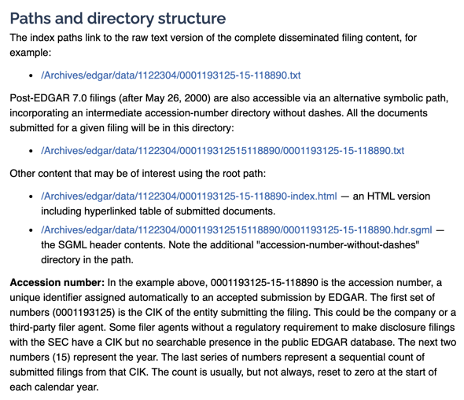
1st step – extract reference data from Master.idx
Here is what we must do to use the accession numbers to our advantage:
Aggregate the (1) time period, (2) CIK, and (3) accession number
Determine what a URL containing the complete Financial Statements will be using those values

Slide 44
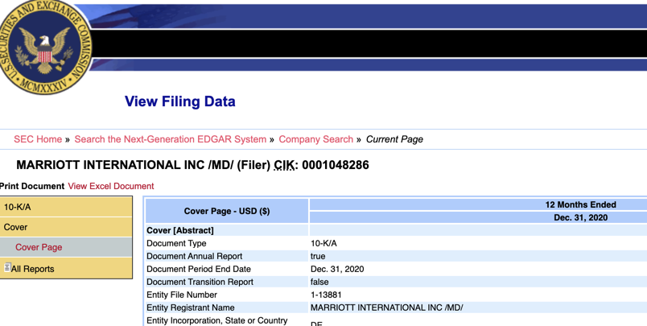
2nd step – find the valuable links on these pages
With a little work, we can retrieve the aggregated financial statements in a single workbook.
This is a 2-step process:
First, use accession number & CIK to land on the index page with the desired financial report in .xlsx format
Second, find the link to the .xlsx report and download it
1
https://www.sec.gov/cgi-bin/viewer?action=view &cik=1048286
&accession_number=0001628280-21-006440
&xbrl_type=v
2

Slide 45
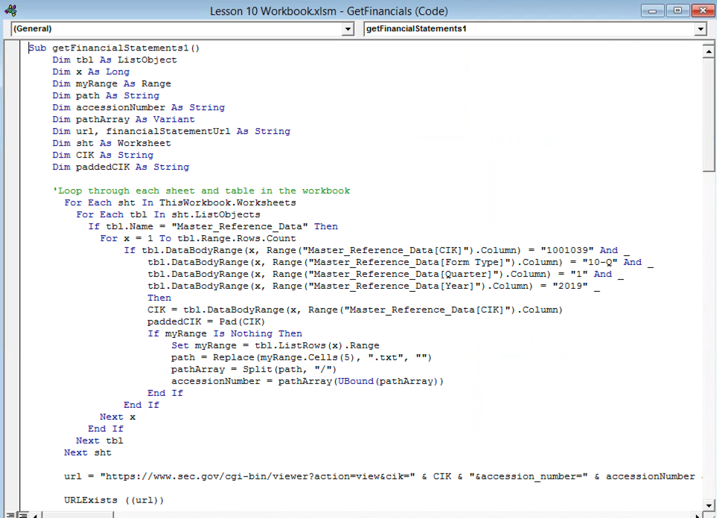
Finally, the VBA code
See the GetFinancialStatements module
We’ll walk through the getFinancialStatements1() macro together
Next, I’ll show you ways to make this easier to use with a User Form in Excel.

Slide 46
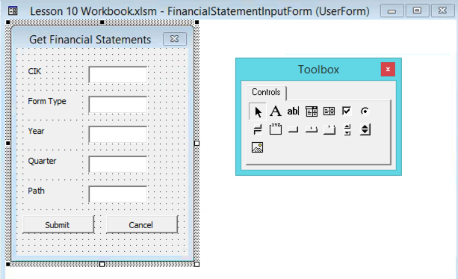
Make our macros easier to use
User forms are a good way to allow users to enter values they want.
It almost is always better than hard coding values into the VBA code.
A form will make this new macro as easy to use as possible
We’ll gather the required values from the selected row in the Reference Data tab

Slide 47
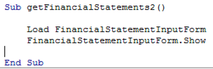
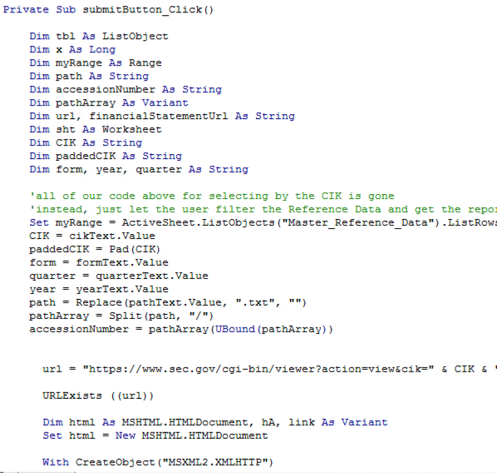
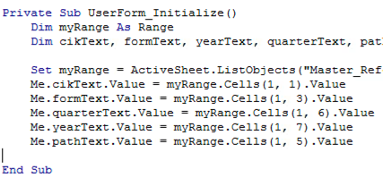
User form basics
1. The macro will call two things:
3. We transfer our macro code to the code that runs after the Submit button is pressed. Only this time, we’re using the values from the form to create the URL.
2. The form will initialize with the values from our table (from selected row)

Slide 48

Summarizing our Excel Options
Our approach isn’t perfect, but it can work around existing constraints.
Benefits
We aggregated all of the indexes (indices?) from previous years into Excel
We can pull the accession number for a given submission
It enables us to scrape the key element, which is a link to the Financial Statements as a .xlsx
Weaknesses
It doesn’t fully automate gathering from multiple periods and multiple companies
Comparative analysis will require more effort
Mmmm, k?
That’d be greeeeeaaaat.

Slide 49
Better APIs

Slide 50
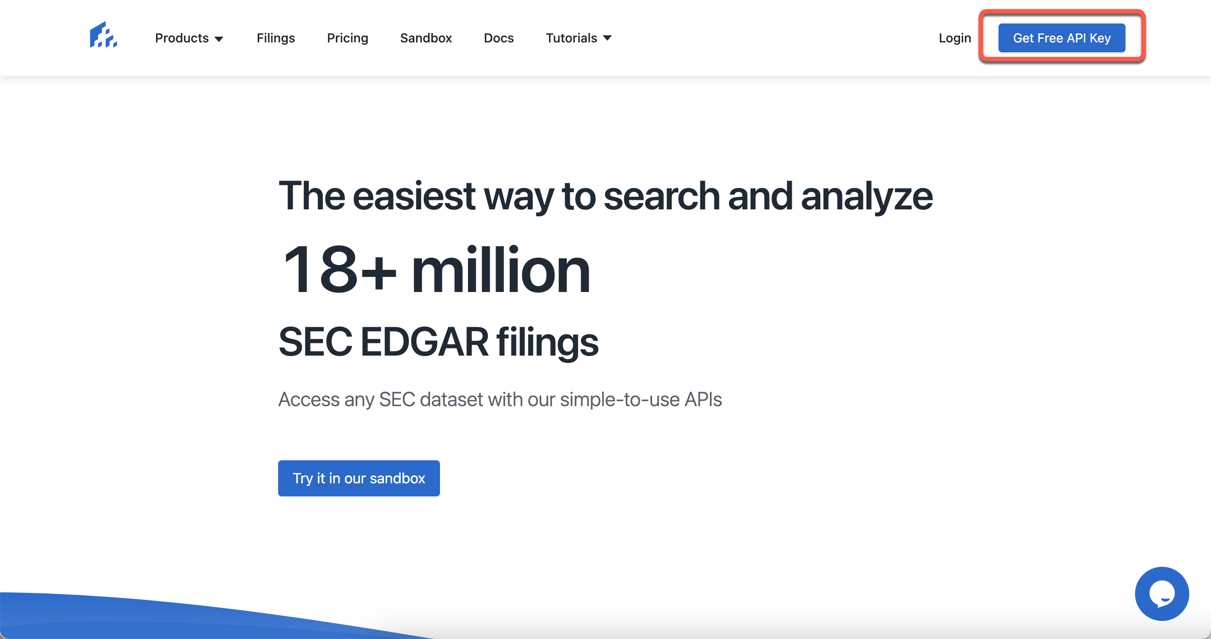

SEC-API.IO
If only someone made this easier…
Benefits
Professional developers have invested time, effort, and testing, to ensure methods for accessing data are reliable
Weaknesses
It isn’t free
The Free API key limits you to 100 requests

Slide 51
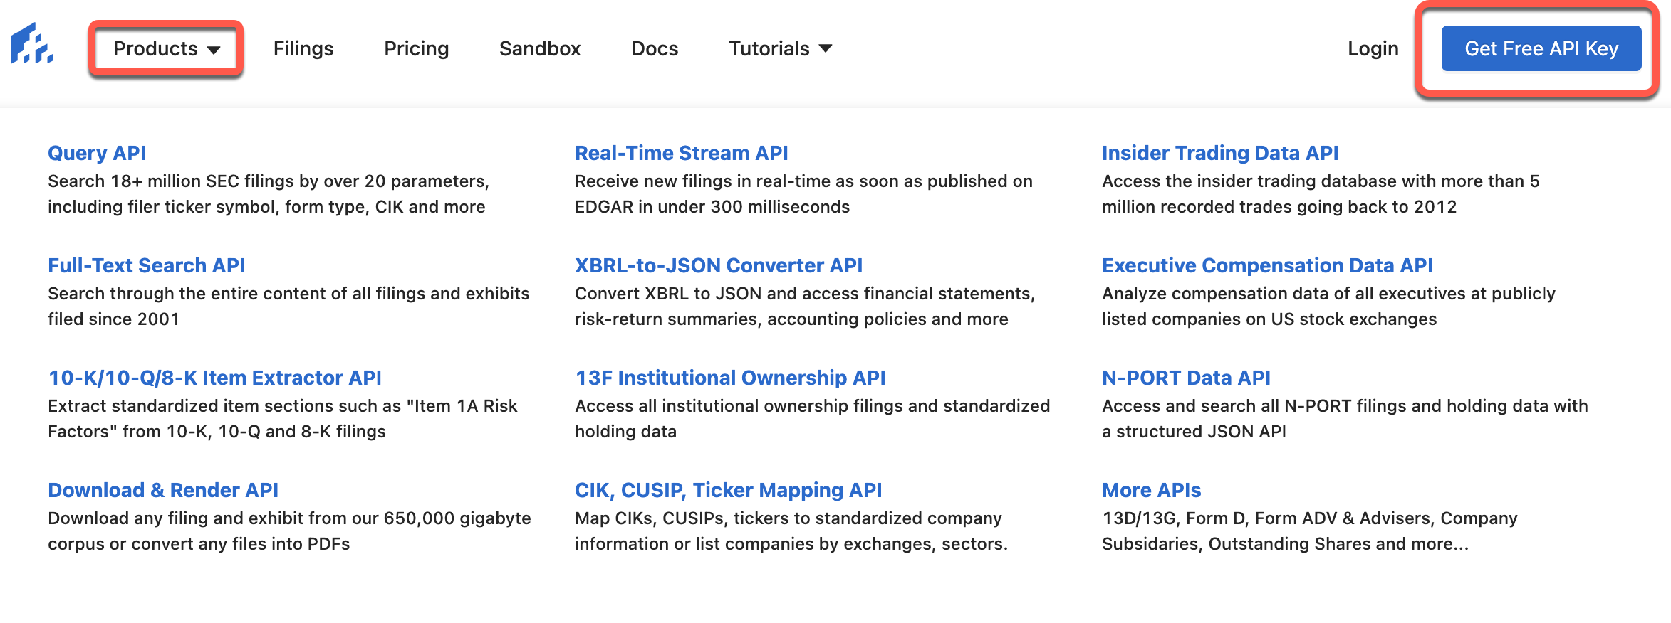
Capabilities of SEC-API.IO
So, what does this API do, exactly?
First, look at the list of products offered. Then, click “Get Free API Key”.

Slide 52
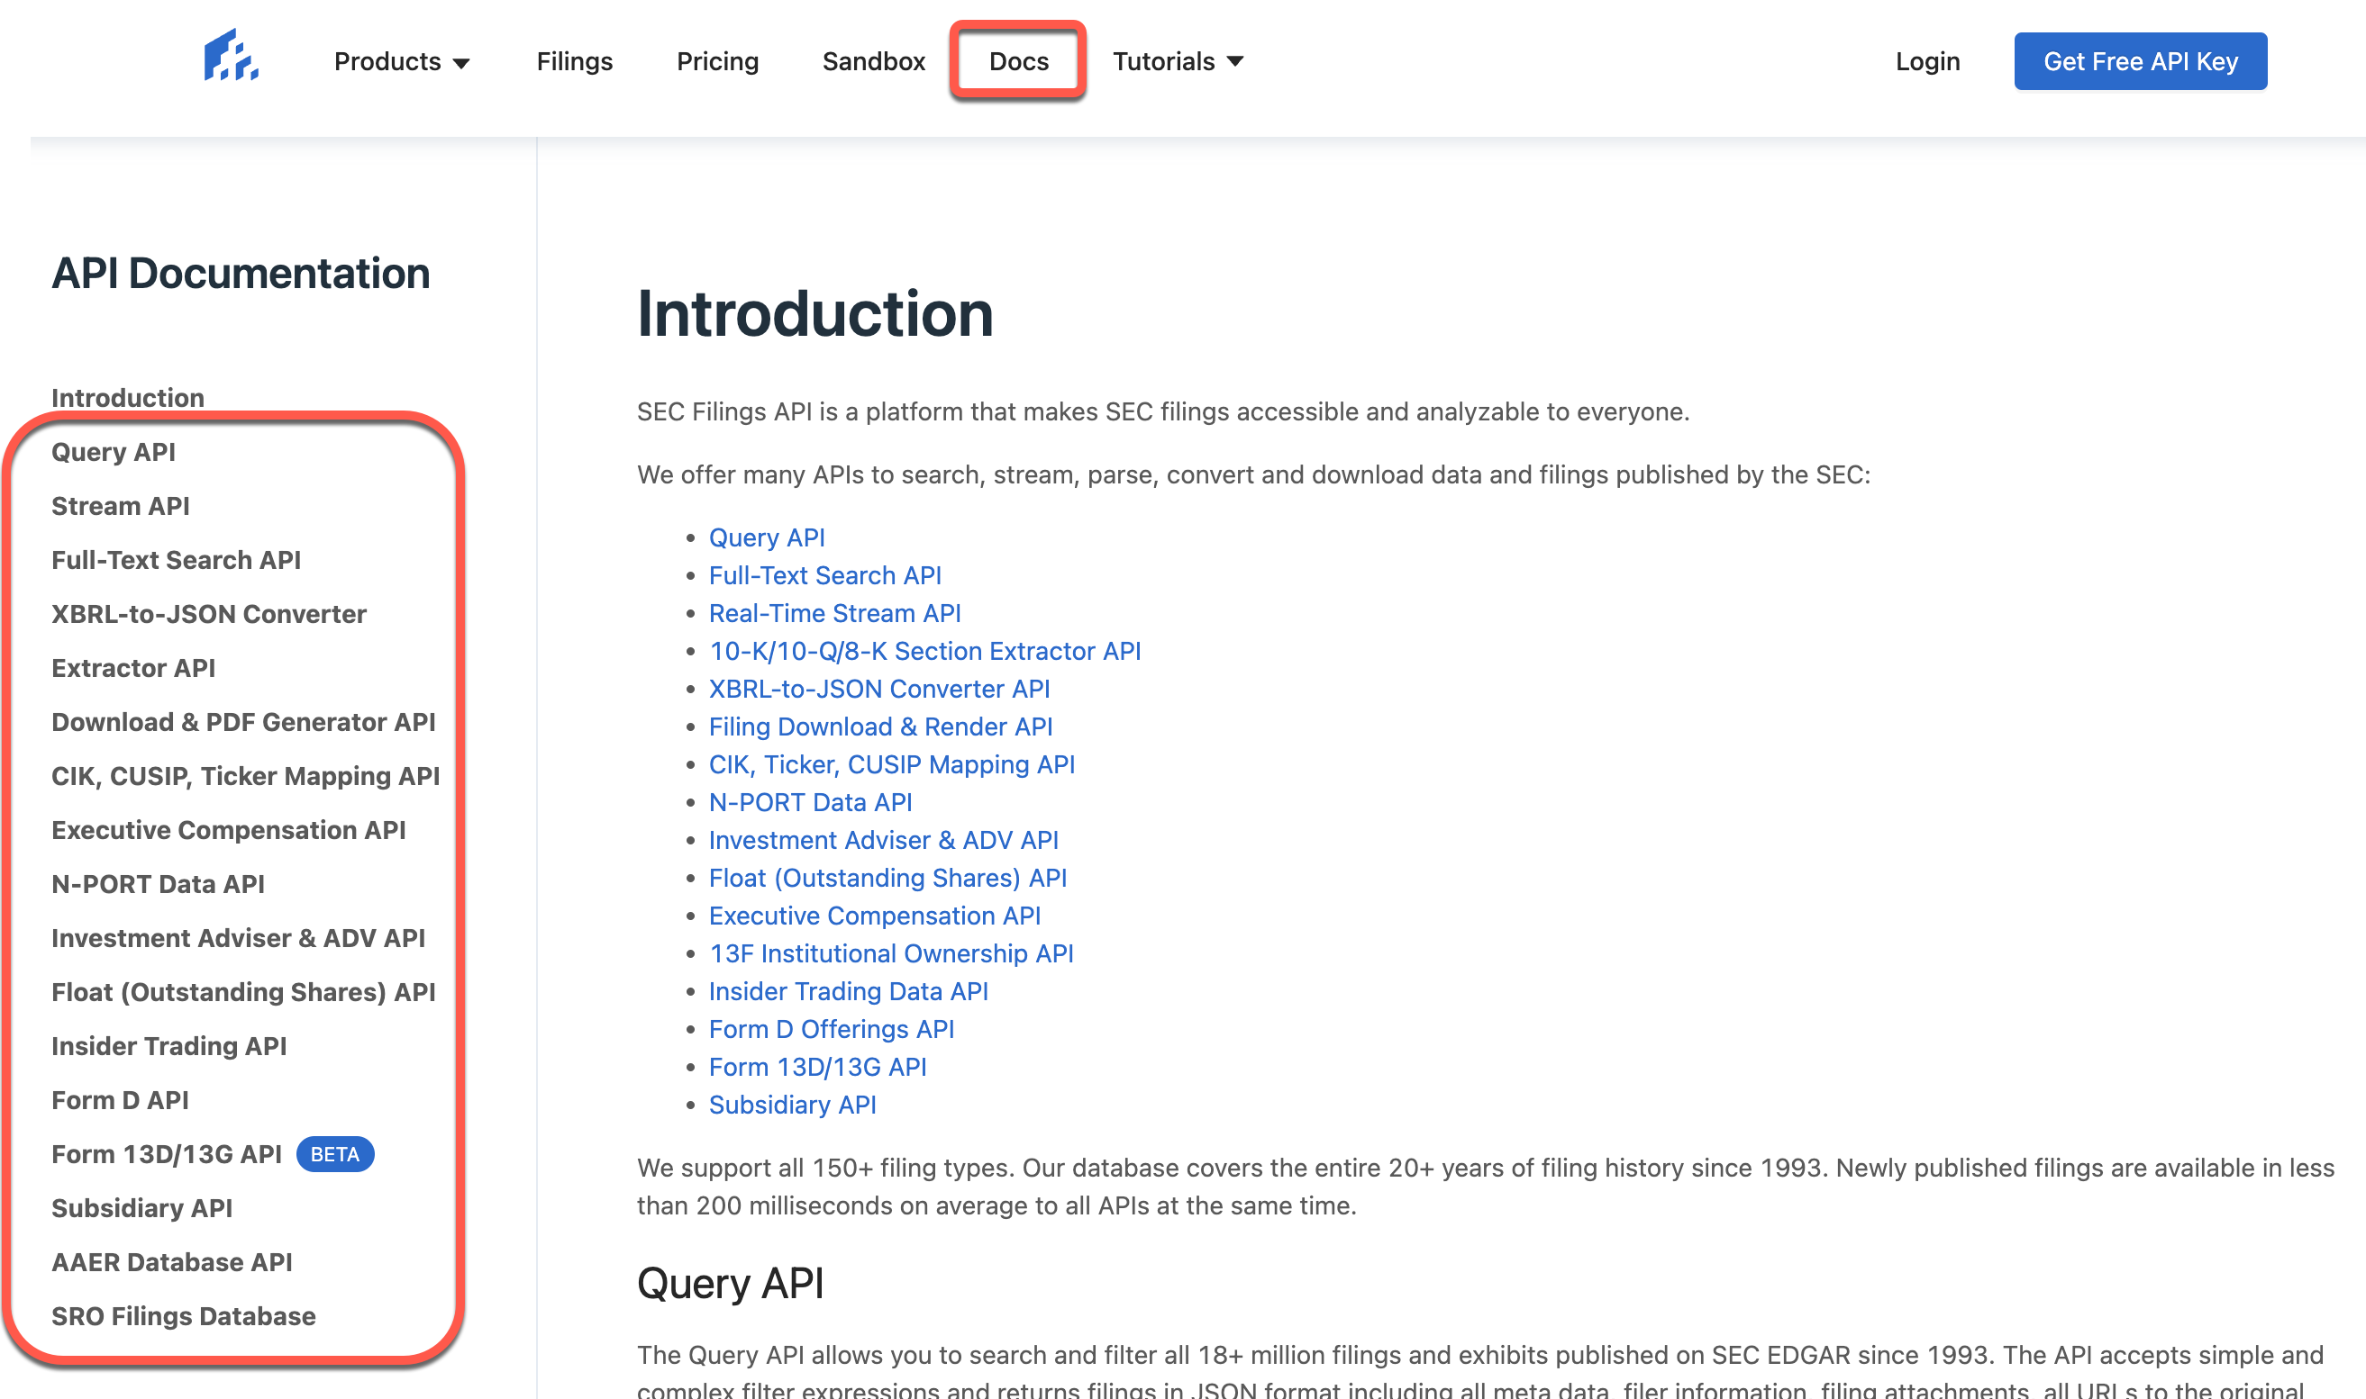
SEC-API.IO Documentation
Every developer loves and appreciates well-written documentation.

Slide 53
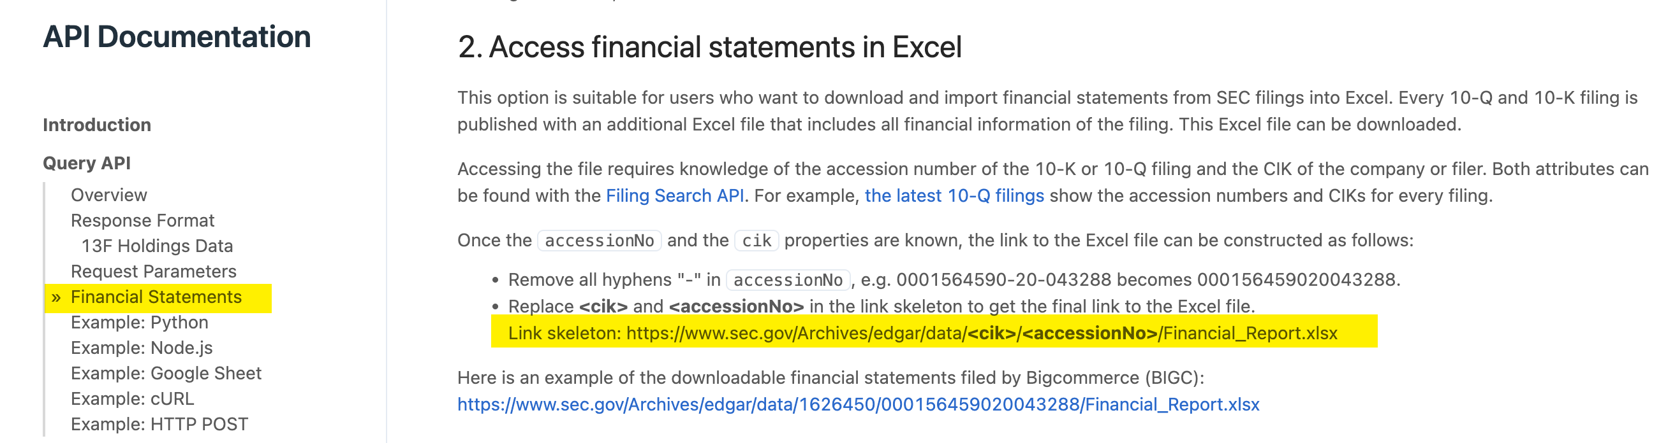
Diving into SEC-API.IO Documentation
What can we learn by reading about the Query API?
This is exactly what we tried to achieve in Excel with previous exercises tonight, but now, it’s going to be much much easier.

Slide 54
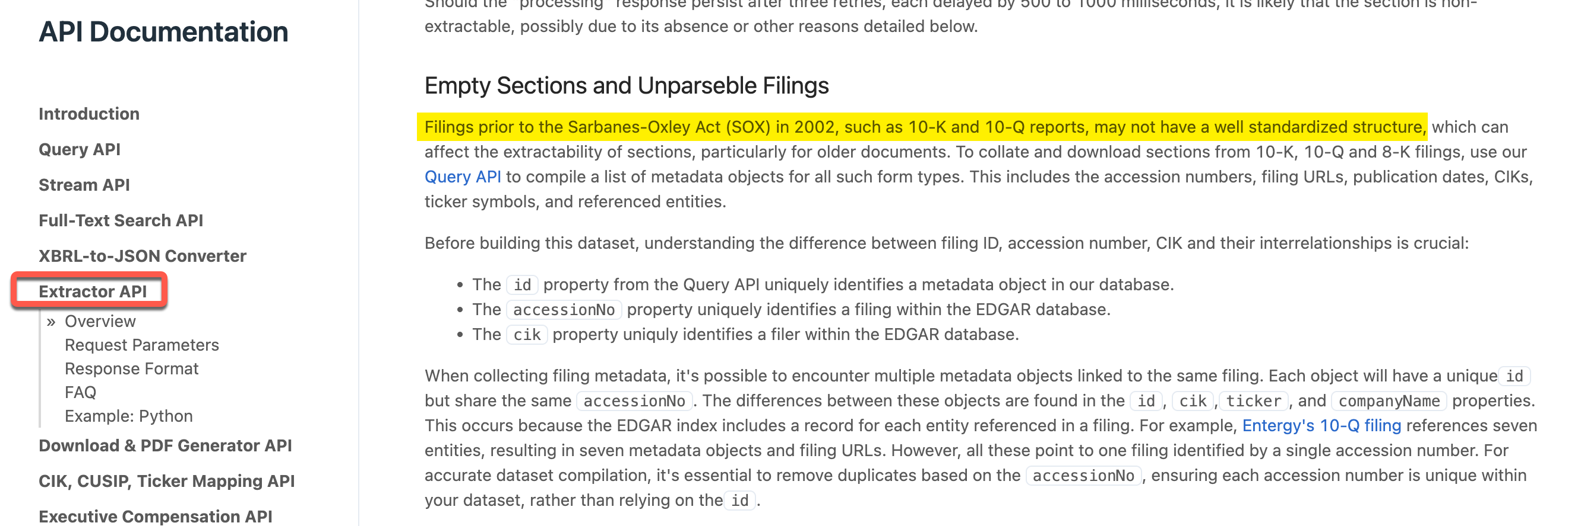
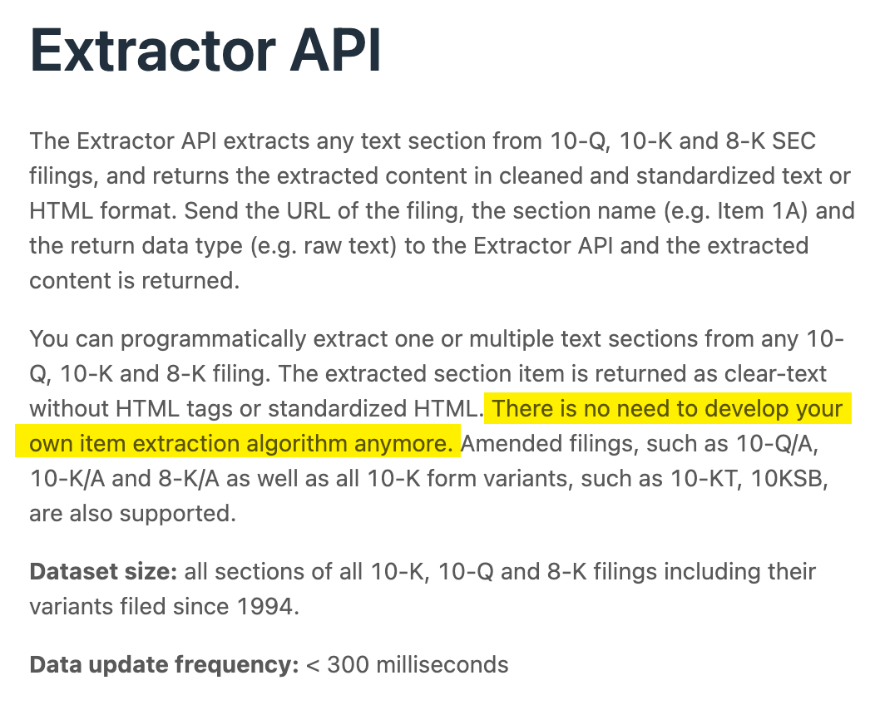
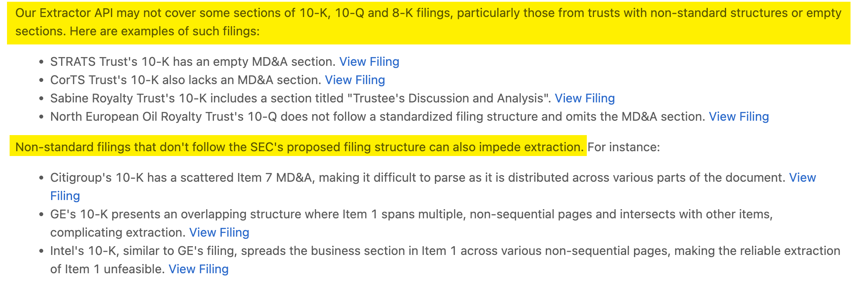
Diving into SEC-API.IO Documentation
What can we learn by reading about the Extractor API?

Slide 55
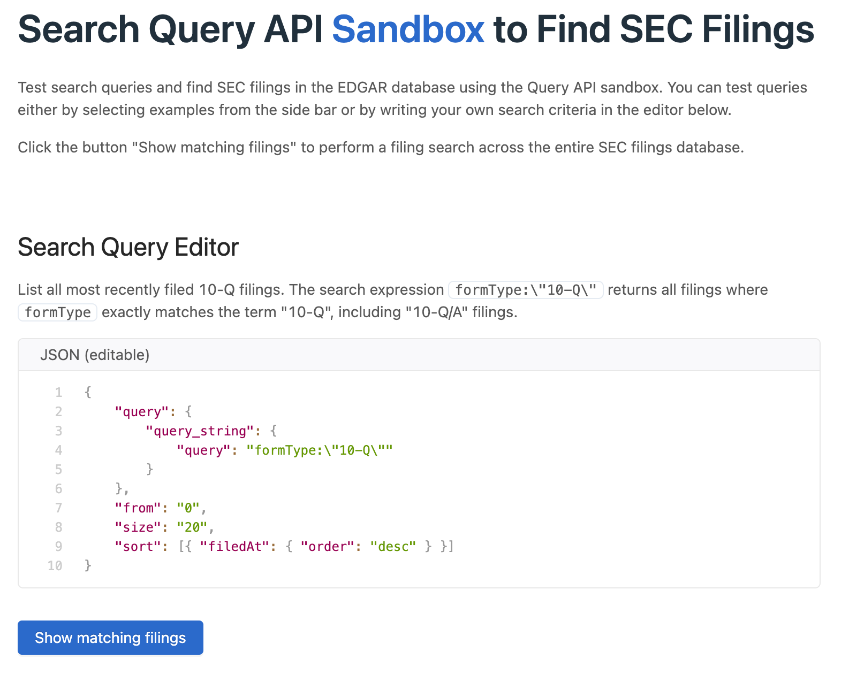
The SEC-API.IO Sandbox
We have a limited number of free requests (currently 100).
As an enabler and helpful demo of its capabilities, SEC-API.IO provides a “sandbox” to allow you to practice requests using the Search Query API.
Go to https://sec-api.io/sandbox and try out a few requests.

Slide 56

The SEC-API.IO Sandbox
Look at what we can do with this thing!

Slide 57

Replicating our Excel and Python Examples from Earlier
Use the ”Search by ticker” function
Be sure to scroll all the way to the right in the Response section.
This will have valuable information: the URLs of the filings in various data formats

Slide 58

Where is the accession number?
Click the option above the tabular data to display the JSON.
This is precisely what is meant when the documentation tells you to:
Replace <cik> and <accessionNo> in the link skeleton to get the final link to the Excel file.
Link skeleton: https://www.sec.gov/Archives/edgar/data/<cik>/<accessionNo>/Financial_Report.xlsx

Slide 59


But wait…there’s more
SEC-API.IO provides several options for accessing their API. Two of these look very interesting.
This is why the cool kids read the documentation!

Slide 60
Python (Google Colab)

Slide 61

Exploring the Python method using Google Colab
SEC-API.IO is also kind enough to show us how to write Python. We’ll just need to customize it.

Slide 62

Your API Key will start counting with each request you make
Try to use this sparingly. We will use it a few more times this semester.

Slide 63
Google Sheets

Slide 64
Using the API within Google Sheets
SEC-API.IO also gives us a method to use the Search API directly within Google Sheets.
Before usage, ensure you copy this sheet into your own workspace. Click ”Extensions" > ”App Script" to open the script editor.
In the file macro.gs replace YOUR_API_KEY with your API key. Click the "Save Project” button to save your changes.
Go back to your sheet, and click "Tools" > "Macros" >"AddFillings".
You have to give permission to the macro script. Important: click "Advanced", then "Accept unsafe version". Once you gave permission, you can click again on "Tools" > "Macros" > "AddFillings".
You can change the query inside the script editor to retrieve different filings.

Slide 65


Editing the Script
Apps Script is a Google feature that uses a coding language called JavaScript

Slide 66

Using the API within Google Sheets
The AddFilings Script available under Extensions -> Macros

Slide 67



Using the API within Google Sheets
Grant permissions to the script

Slide 68

Final Result
Nice!

